Slide 1

“Towards the Semantic MOOC: Extracting, Enriching and Interlinking E-learning Data in Open edX Platform”
Dmitry Volchek, Aleksei Romanov and Dmitry Mouromtsev – Laboratory ISST @ ITMO University, St. Petersburg, Russia
KESW 2017

Slide 2
It is easy to say that people need to keep learning throughout their careers. The practicalities are daunting
Notes:
These are the covers of the Economist special reports about lifelong education. It’s well known, that learning during the whole life brings lots of benefits and more and more often it’s the only way to stay up to date in todays circumstances. But of course we can say a lot of right words, argue about the details, choose paths, agree and disagree with each other – truth is quiet simple: Easier said than done.

Slide 3






Notes:
Ok, I want to learn something. What should I choose? University education is great, but it’s expensive and more suitable for youngsters. Offline corporate trainings? Maybe, but it’s quiet expensive too? Self education? Yes, but it’s hard to find suitable books and create an educational plan.

Slide 4


Notes:
Moocs were first introduced in 2008 and emerged as a popular mode of learning in 2012. Early MOOCs often offered open-access features, such as open licensing of the content to promote the reuse and remixing of resources. Some later MOOCs use closed licenses for their course materials while maintaining free access for the students. Now MOOCs are seen as a major part of a larger disruptive innovation taking place in higher education. Almost every big University anyway is involved in this process. Students appreciate the convenience of MOOCs usage as well.

Slide 5
MOOC statistics
Notes:
This picture shows the growth of MOOCs. As you can see – at the moment Educational Institutions provide a wide amount of courses at various directions. On the one hand it’s wonderful if the student has choice, but on the other hand it may cause some troubles. Which course satisfies all the needs and expectations of the specific student? Such a problem could be solved if we would have enough information about a MOOC and its content.

Slide 6
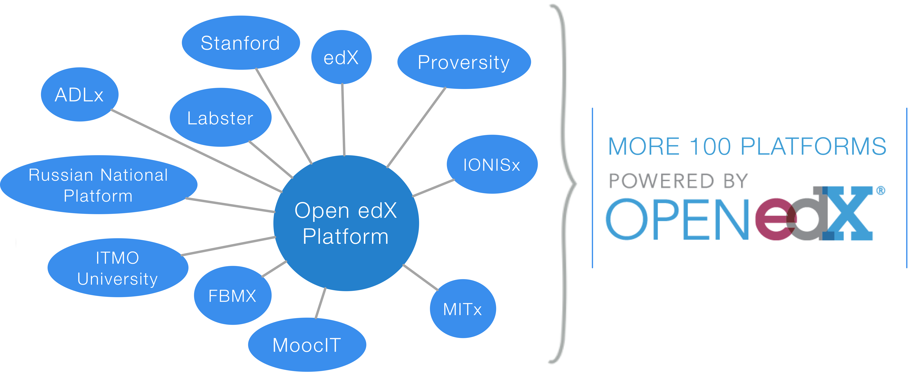
Notes:
EdX.org is the second most popular MOOC provider. The basis is Open edX platform is used not only at edx.org, but also by many other providers of educational services. Among the most popular it is possible to allocate about 100 organizations that have deployed the platform and the number is growing.

Slide 7
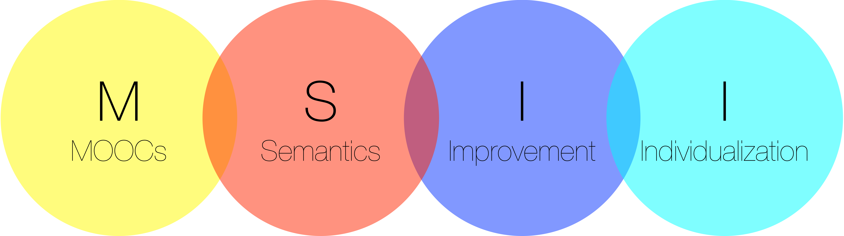
Notes:
We believe that the educational process can be improved. To do so, it is necessary to empower MOOCs the ability to adapt to the learner’s needs (individualization). The creation of the tools for course creators would also add benefits. Thus, we offer the concept of MSII - i.e. Use of semantic technologies in MOOCs for individualization and improvement.

Slide 8
Notes:
Here is the example of the Open EdX course lecture. Even if the lecture is actually a video lecture, almost everytime it has subtitles. So we may work with text and extract concepts of a specific course component. Thus if we store course’s data including the concepts at one RDF storage we may indirectly link and reuse courses that use the same concepts.
If the learner is not familiar with the concept she has encountered at the course she may see it’s description, navigate to the other components of this course or to the other courses that use this concept. This way we can adapt learning system for the needs of the exact user ( user behavior)
Course creators may analyze the correspondence between lectures and quizzes and improve the course.

Slide 9
Notes:
To store course information and the concepts we developed the ontology which is based on the core ontologies (SKOS, TEACH, FOAF). The most significant part of the ontology is the course hierarchy description and Concept – Domain part. At the first look it seems quiet simple to make a class called “course component” for example and define sections, subsections etc. as its subclasses. But when we started working with the Open EdX storage (courses are stored at Mongo database) we discovered that each component has more information than it may seem. So we defined them as different classes. At the top you may see classes called concept, candidate and Knowledge Domain – I’ll tell you about them a bit later.

Slide 10
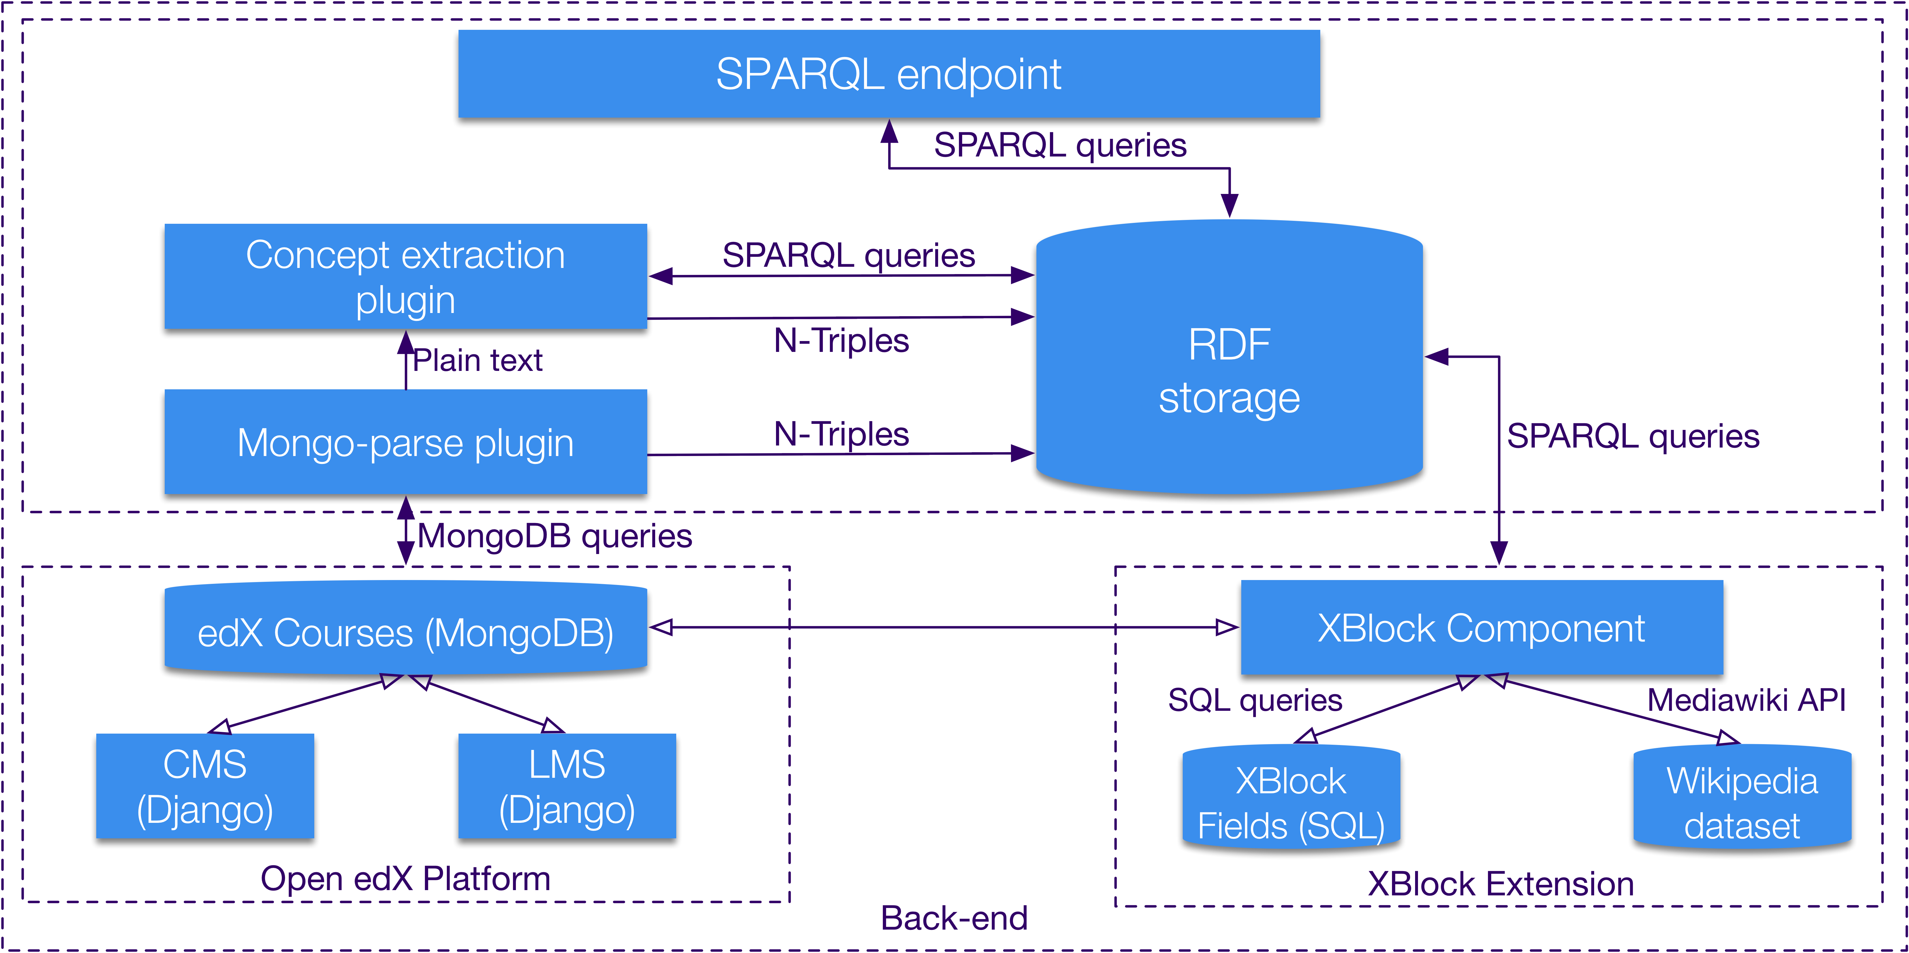
Notes:
To form the semantic core of the system we should make 2 steps:
Extract data from nosql database MongoDB
Parse it according to the developed ontology to n3 format
During the parsing we search for the concepts using NLP algorithm (I’ll show on the next slide) and compare them with already existing concepts of the Xblock. The Xblock is the only way of extending open EdX platform and it is stored like other course components.
As a result all the course data and extracted concepts form the RDF storage, available for the external use.

Slide 11
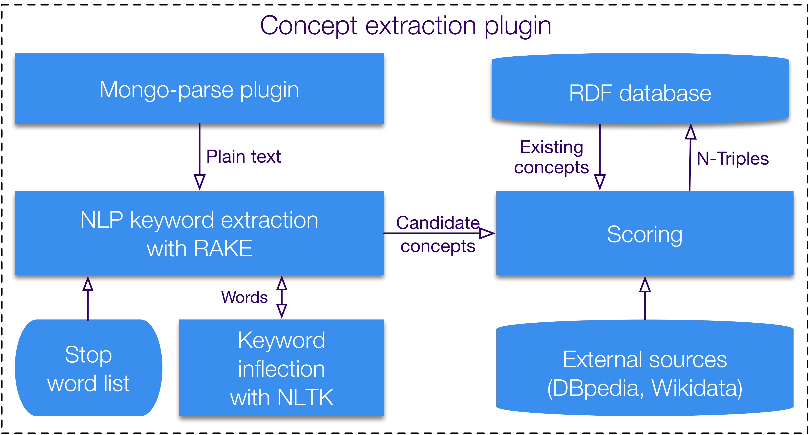
Notes:
Concept extraction plugin analyses plain text. We used RAKE algorithm (Rapid Automatic Keyword Extraction) to extract the concepts. It uses stop word list and the inflection mechanisms to improve the quality of the extracted words. That’s how the concept candidates array is formed. Then the candidates are compared to the external sources and the already existing concepts in the RDF storage. After that candidates are exported to the RDF storage.

Slide 12
Results
12k encounters
2,5k unique concepts
Notes:
To test our method we took 6 courses. Here you can see the results of parsing and ontology mapping. Generally we extracted almost 12k concept encounters and 2,5k unique concepts. Evaluating this information we can say that every concept is encountered almost 5 times, but in detail.

Slide 13
Concept usage in all courses components
Notes:
In detail we see that about a hundred concepts is used frequently enough and more than 15 hundred is used only 1 time. We even didn't put them on the diagram

Slide 14
Concept usage in the courses
Notes:
There is no concept which is used at all 6 courses and more than 18 hundred are used only in one course. Actually we would like to try our method on a bigger number of courses, but there’s no such a possibility at the moment.

Slide 15
Conclusion
Full course data represented in the RDF storage
Learners may navigate via concepts within a single course and between different courses
Future work
Individualization
Improvement
Notes:
Full course data is represented in the RDF storage
Learners may navigate via concepts within a single course and between different courses.
As the future work we are going to create recommendation services for learners and creators.

Slide 16
Thank you

